Slide 1
Java Script Events

Slide 2
Event
HTML events are "things" that happen to HTML elements.
When JavaScript is used in HTML pages, JavaScript can "react" on these events.

Slide 3
Events
Here are some examples of HTML events:
An HTML web page has finished loading
An HTML input field was changed
An HTML button was clicked

Slide 4
Types of events in JavaScript
There are multiple types of events in JavaScript, such as:
1) MOUSE EVENTS
2)KEYBOARD EVENTS
3)FORM EVENTS
4)WINDOW EVENTS

Slide 5
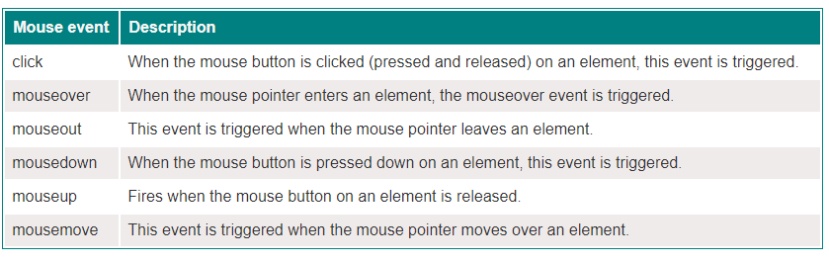
JavaScript mouse events
Several mouse events are available in JavaScript that can be used to react to user interaction with a web page. The following are a few of the most typical mouse events:

Slide 6
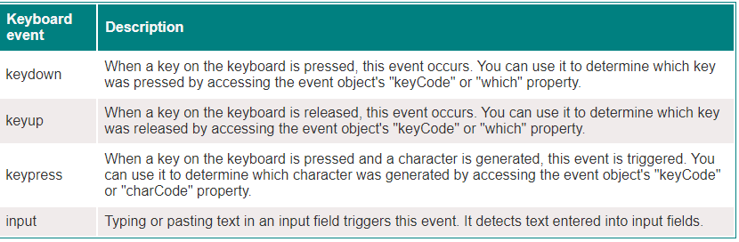
JavaScript keyboard events
There are several keyboard events in JavaScript that you can use to detect when a user interacts with the keyboard on a web page. The following table lists and describes the keyboard events in JavaScript:

Slide 7
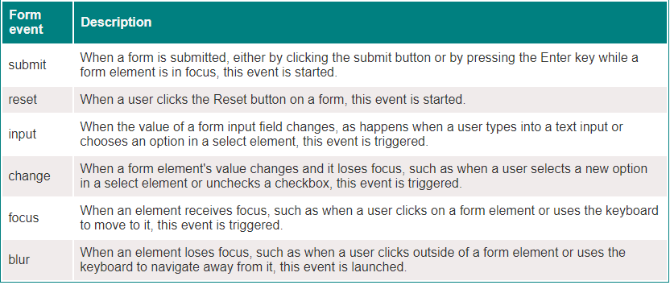
JavaScript form events
Several events in JavaScript can be used to monitor changes and interactions with HTML forms. The following table lists and describes the form events in JavaScript

Slide 8
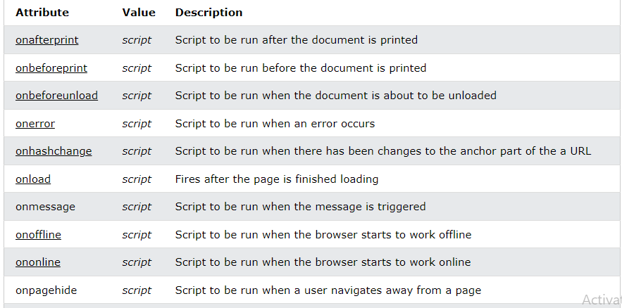
Java Script Window Events

Slide 9
